Slide 1
2D LIDAR SLAM SIMULATION
Group 6
何润 齐睿 宋雨辰 田若瑶 曾嘉龙

Slide 2
Contents
1. Introduction
2. Problem Formulation
3. Methodology & Implementation
4. Results & Discussion
5. Conclusions

Slide 3
Introduction of our team
֍ 何润 Run He
Close-loop detection (pose optimization)
֍ 齐睿 Rui Qi
Find data set, pose estimation, debugging
֍ 宋雨辰 Yvchen Song
Update map data, plot the final map and path
֍ 田若瑶 Ruoyao Tian
Data preprocessing and coordinate transformation
֍ 曾嘉龙 Jialong Zeng
Find Lidar parameters and build grid map
Coding, prepare the PPT and report

Slide 4
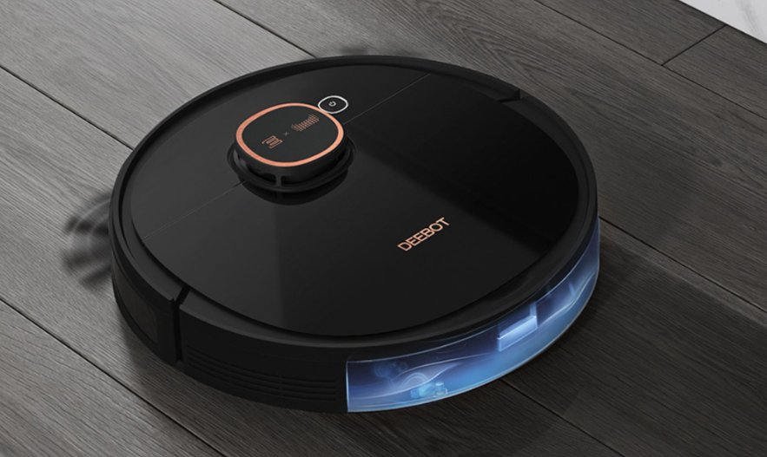
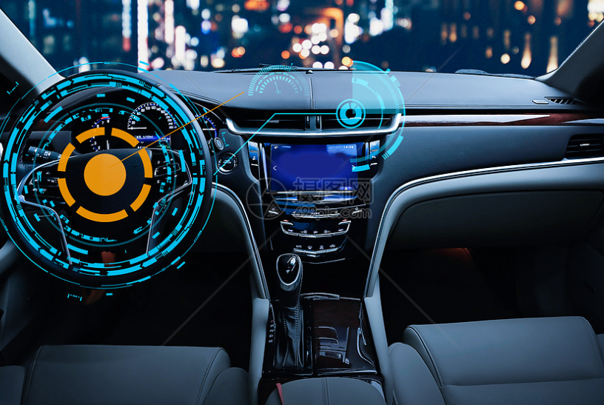
Introduction of our project
What is SLAM ?
A technology for pose estimation and map construction of mobile robots based on sensor data.
Why do we need SLAM ?
֍ Robot has to realize its position to complete its tasks independently, such as cleaning a room, self-driving.
֍ GPS is not perfectly available everywhere (especially indoor).
What do we want to learn ?
Have a rough view on some basic SLAM methods, such as coordinate system transformation, graph-based optimization, close loop detection, etc.

Slide 5
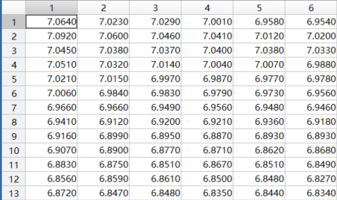
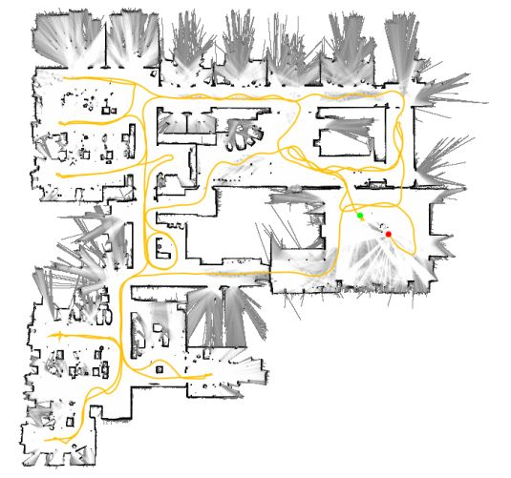
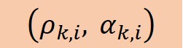
Problem Formulation
What we want:
The map built from the LIDAR scanning data and the path of the mobile robot
What do we have :
2D LIDAR scanning data for many batches
Range and angle:
$$\left(ρ_{k,i}, α_{k,i}\right)$$
https://zhuanlan.zhihu.com/p/93713565

Slide 6
Set parameters
Problem Formulation
Load 2D LIDAR scanning data
First batch or not?
Y
Data initialization
N
Transformation of coordinate system
Build grid map
(point occurrence and distance)
Correct the pose estimation
Pose estimation
Loop closure detection
Need loop closure or not?
Y
N
Plot the map and the path
Notes:
数据收集
前端：数据关联，位姿估计
后端：优化
回环检测减小预测的误差

Slide 7
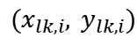
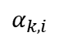
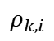
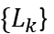
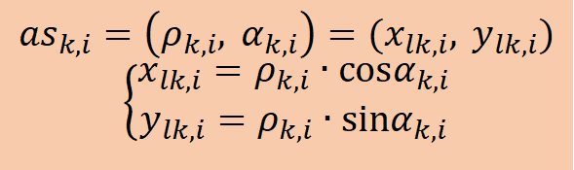
Methodology: Data Preprocessing and Initialization
1. Filter out the available data: Not all original scan data is reliable. The scan data’s range shouldn’t be too large or close to the maximum value.
$${AS}_{k}=\left\{{as}_{k,1},{as}_{k,2},…,{as}_{k,j}\right\},R_{min}<ρ_{k,i}<Threshold, k∈\left(1, 2,…, 5522\right)$$
2. Convert the available data from polar coordinates to Cartesian coordinates.
$${as}_{k,i}=\left(ρ_{k,i}, α_{k,i}\right)=(x_{lk,i}, y_{lk,i})$$
$$\left\{\begin{matrix}x_{lk,i}=ρ_{k,i}∙cosα_{k,i} \\ y_{lk,i}=ρ_{k,i}∙sinα_{k,i}\end{matrix}\right.$$
$$y$$
one scan data
$$(x_{lk,i}, y_{lk,i})$$
3. Initialization: The initial position of the robot is considered to be the origin of the global coordinate system. Add the first batch of data into the map directly.
$$ρ_{k,i}$$
$\{L_{k}$}
$$α_{k,i}$$
$$x$$

Slide 8
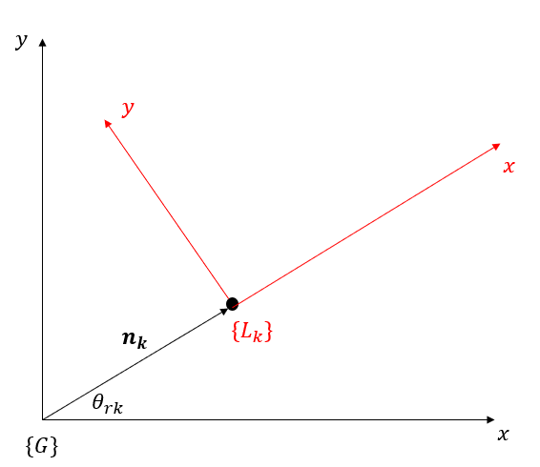
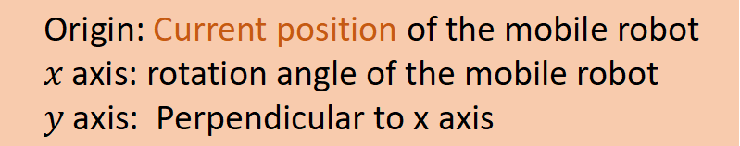

Methodology: Coordinate System Transformation
What about the other batches of data?
We need some tools to help us calculate & estimate & optimize the pose and the map.
Global Coordinate system (we create the map in this system)
Origin: initial position of the mobile robot
$x$ axis: horizontal direction
$y$ axis: vertical direction
Local Coordinate system:
Origin: Current position of the mobile robot
$x$ axis: rotation angle of the mobile robot
$y$ axis: Perpendicular to x axis
Scan data
Map data
Local
Coordinate Transformation
global

Slide 9
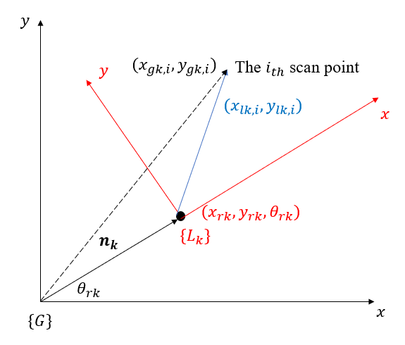
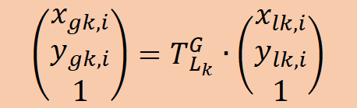
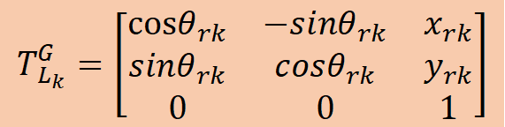
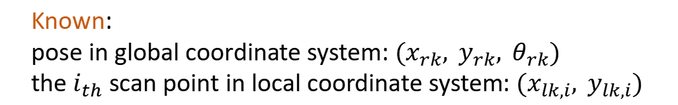
Methodology: Coordinate System Transformation
For example: robot begins its $k_{th}$ scan
Known:
pose in global coordinate system: $(x_{rk}, y_{rk}, θ_{rk})$
the $i_{th}$ scan point in local coordinate system: $(x_{lk,i}, y_{lk,i})$
Write:
translation matrix
$$T_{L_{k}}^{G}=\left[\begin{matrix}cosθ_{rk} & −sinθ_{rk} & x_{rk} \\ sinθ_{rk} & cosθ_{rk} & y_{rk} \\ 0 & 0 & 1\end{matrix}\right]$$
Transformation:
$$\left(\begin{matrix}x_{gk,i} \\ y_{gk,i} \\ 1\end{matrix}\right)=T_{L_{k}}^{G}∙\left(\begin{matrix}x_{lk,i} \\ y_{lk,i} \\ 1\end{matrix}\right)$$

Slide 10
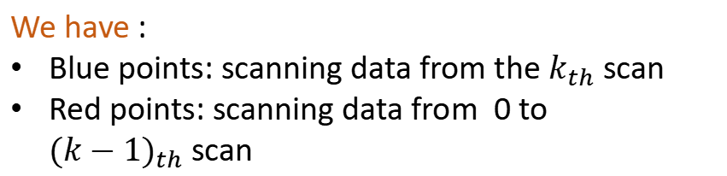
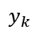

Methodology: Construction of The Grid Map
$$y$$
What is grid map:
An auxiliary map which can measure the surrounding environment of the robot.
It helps us determine the location of the scan points and then do pose correction.
$$y_{k}$$
$$x_{k}$$
We have :
Blue points: scanning data from the $k_{th}$ scan
Red points: scanning data from 0 to ${(k−1)}_{th}$scan
$$x$$
Scan hit points of scan k
Scan hit points of scan 0 to k-1

Slide 11
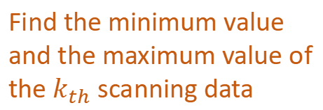
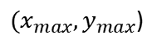
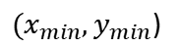
Methodology: Construction of The Grid Map
Step 1 : Extract the points surrounding the $k_{th}$ pose.
$$y$$
$$y$$
$$y$$
extracted point set
${(x}_{max},y_{max}$)
$$y_{k}$$
${(x}_{min},y_{min}$)
$$x_{k}$$
Coordinate system transformation
$$x$$
$$x$$
$$x$$
Find the minimum value and the maximum value of the $k_{th}$ scanning data
Extract a point set based on them

Slide 12
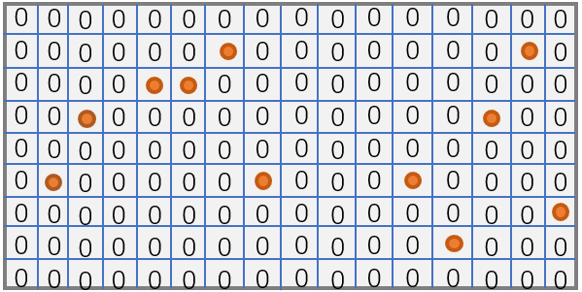
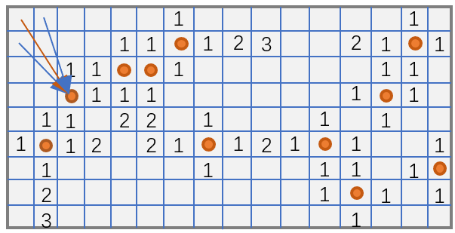
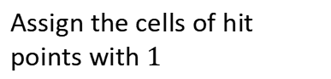
Methodology: Construction of The Grid Map
Step 2 : Build the grid map – Map of point occurrence & Map of distance
$$y$$
From global coordinate to grip coordinate
For each cell in grid map, calculate the distance to its nearest hit point.
Assign the cells of hit points with$1$
$$x$$
Final matrix can quantize the surrounding environment of the robot in current pose.
Map of point occurrence
Map of distance

Slide 13


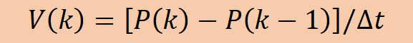
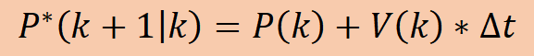
Pose Estimation: Kinematic Model Estimation
Assumption: Robot moves at low speed
Time span between two scan is small
Kinematic Model
$$P^{∗}\left(k+1 | k\right)=P\left(k\right)+V\left(k\right)∗∆t$$
Time span between two scan is small:
Pose:
$$P={[x,y,θ]}^{T}$$
$$V\left(k\right)=\left[P\left(k\right)−P\left(k−1\right)\right]/∆t$$
Equation for pose Estimation
Velocity:
$$V={[\dot{x},\dot{y},\dot{θ}]}^{T}$$
$$P^{∗}\left(k+1 | k\right)=P\left(k\right)+P\left(k\right)−P(k−1)$$

Slide 14
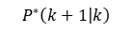
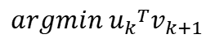
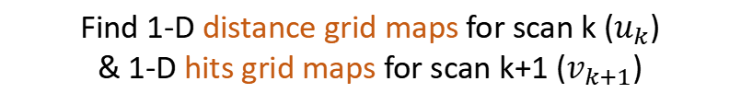
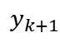
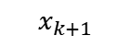
Pose Estimation: Scan to Scan Match
Kinematic model is not accurate: optimize pose by the scan data
One similar area
Similarity in some areas.
$$y$$
Try to make the difference smaller.
$$y_{k+1}$$
$$x_{k+1}$$
$$y_{k}$$
$$x_{k}$$
Find 1-D distance grid maps for scan k ($u_{k}$)
& 1-D hits grid maps for scan k+1 ($v_{k+1}$)
$$x$$
Scan hit point of scan k
$$argmin {u_{k}}^{T}v_{k+1}$$
Objective Function
Scan hit point of scan k+1
$$P^{∗}\left(k+1 | k\right)$$

Slide 15
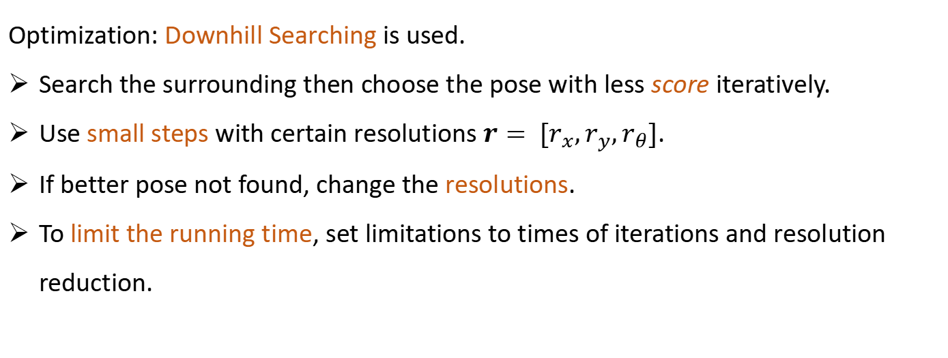
Pose Estimation: Scan to Scan Match
Optimization: Downhill Searching is used.
Search the surrounding then choose the pose with less score iteratively.
Use small steps with certain resolutions $r= [r_{x},r_{y},r_{θ}]$.
If better pose not found, change the resolutions.
To limit the running time, set limitations to times of iterations and resolution reduction.

Slide 16
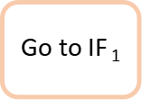
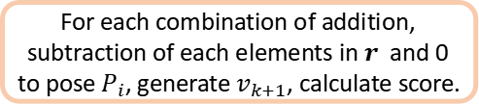
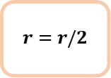
Pose Estimation: Scan to Scan Match
Times < N and
Pose_n = Pose
Initialization
Times != 0
Yes
Score = 0;
Times = 0;
Pose_n = Pose
IF₁
Yes
IF₂
$$r=r/2$$
$$\text{Go} \text{to} \text{IF} \text{1}$$
No
No
Yes
For each combination of addition, subtraction of each elements in $r$ and 0 to pose $P_{i}$, generate $v_{k+1}$, calculate score.
No
IF₄
All combination run out?
END
Go to IF₄
No
IF₃
Yes
Score = score;
Pose_n = P
Score > score

Slide 17
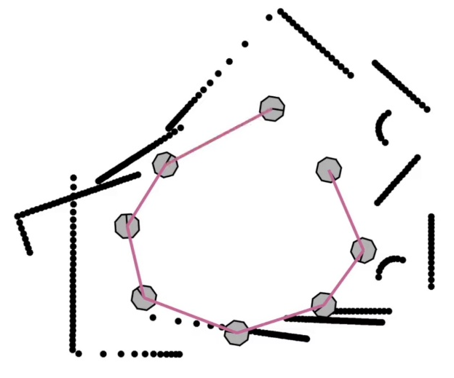
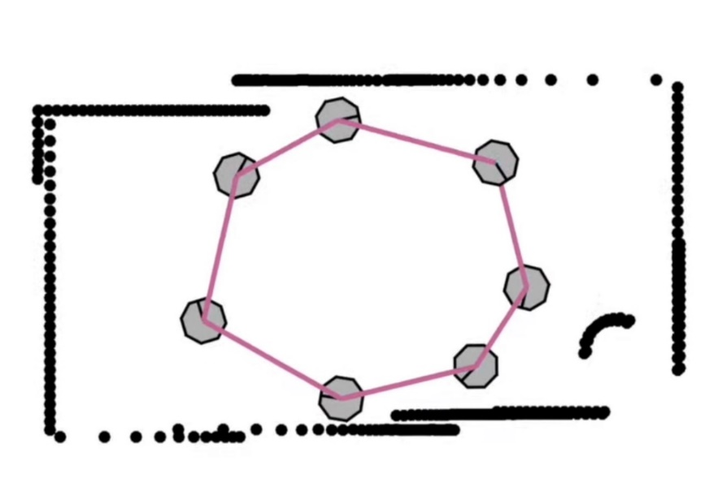
Pose Estimation: Loop Closure Optimization
Keep optimizing pose with previous scan and pose
Accumulated error
Loop closure optimization: Use scan far previous in time with less error to optimize the new pose then reduce the accumulated error.
Loop: The path robots move back to similar position. The start and end points of the loop should have similar map. Correct the pose with similar method in scan to scan match.

Slide 18
Pose Estimation: Loop Closure Optimization
Detect the loops at a certain scan:
Back skip some scans to assure the detected point is far enough.
2. Searching back until the distance between searched point and the new pose is near enough.
Optimization:
Use more precise resolution to do the scan to scan match to get an optimal of new pose.
No need to do optimization at each step. Put a marker on the scan that need to use the loop closure every certain steps.
If needed optimization
Detect loop for the new pose
Optimize the new pose
Go to next scan

Slide 19
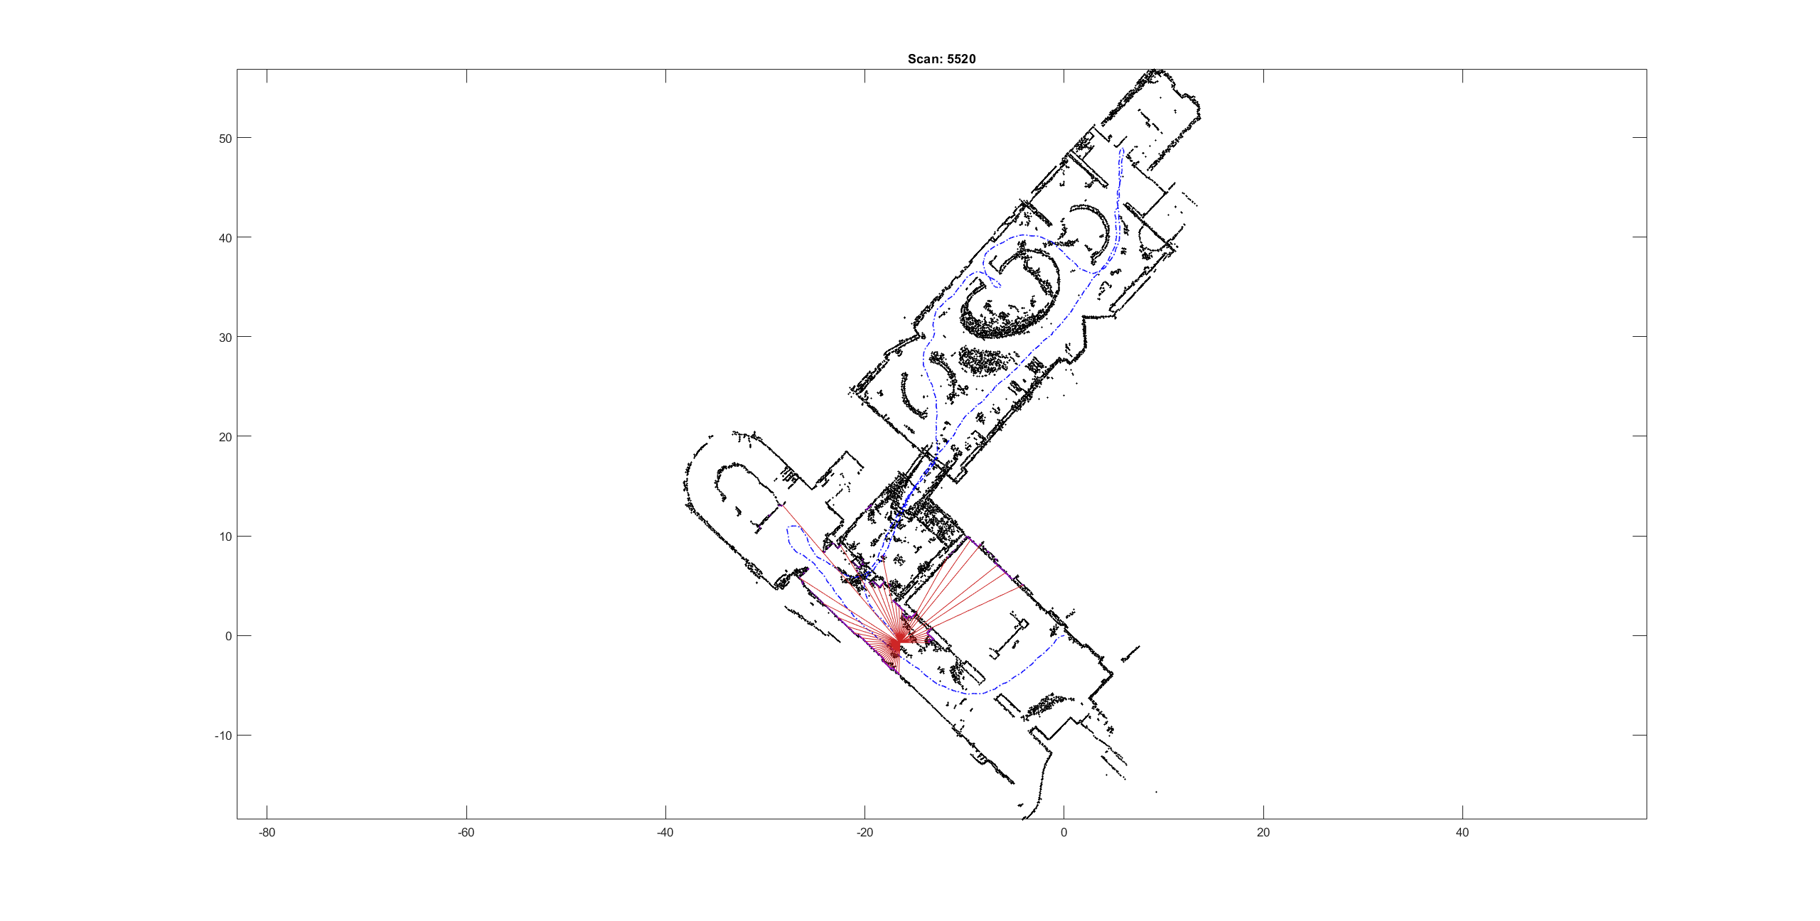
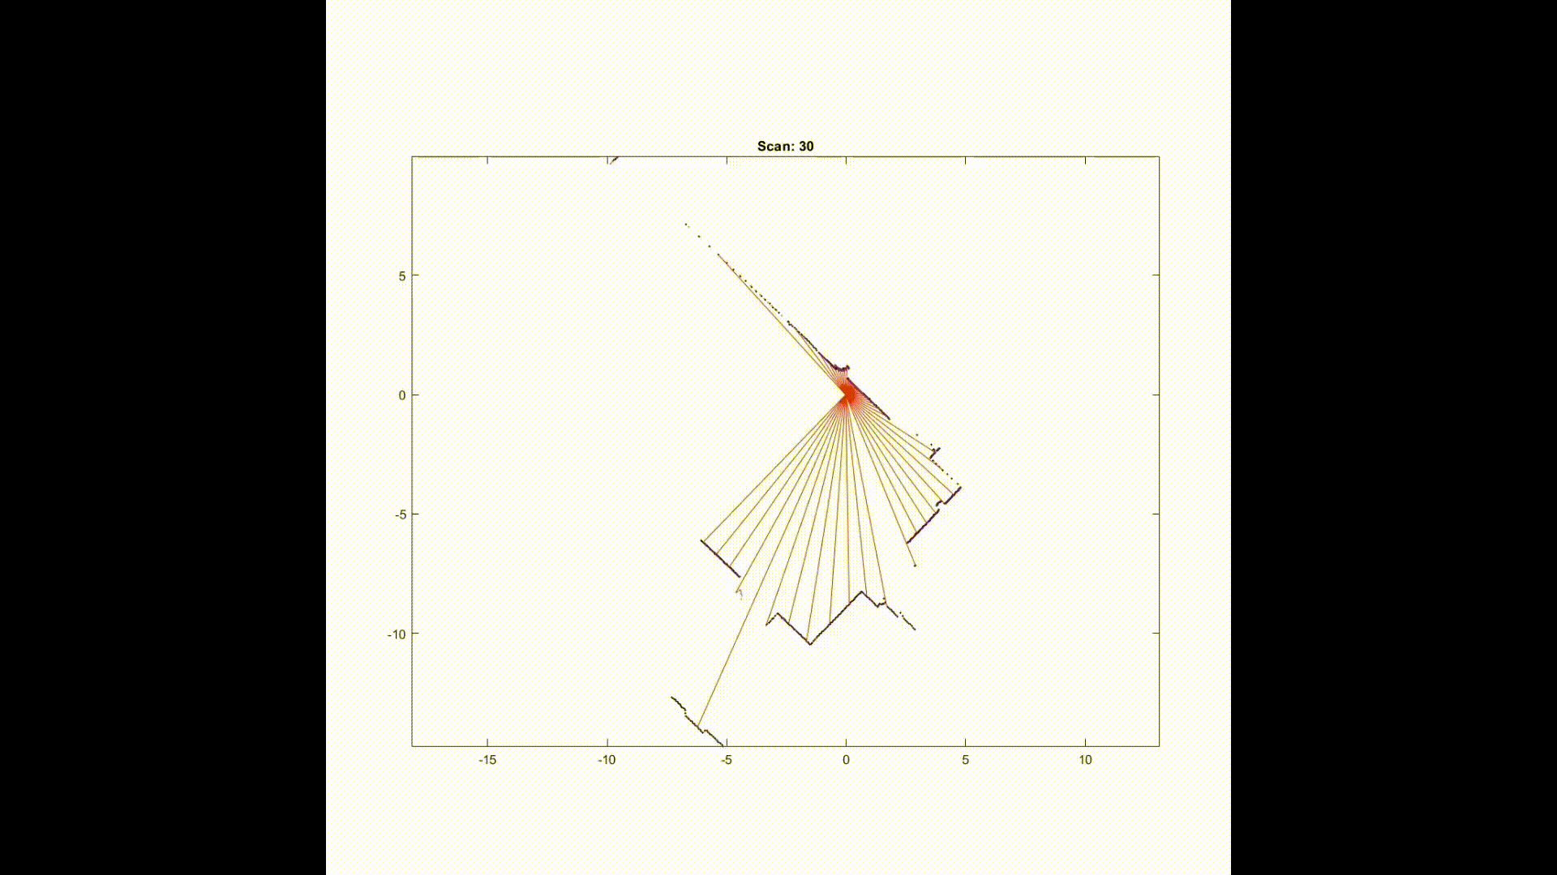
Result and discussion
Implementation Demo
Recording accelerated
Implementation result on MATLAB.
Notes:
We have implemented the process of using lidar data to form robot path and build maps via MATLAB. On this basis, we tried close-loop optimization algorithm based on brutal search, which reduced the cumulative error in the map construction process to a certain extent.

Slide 20
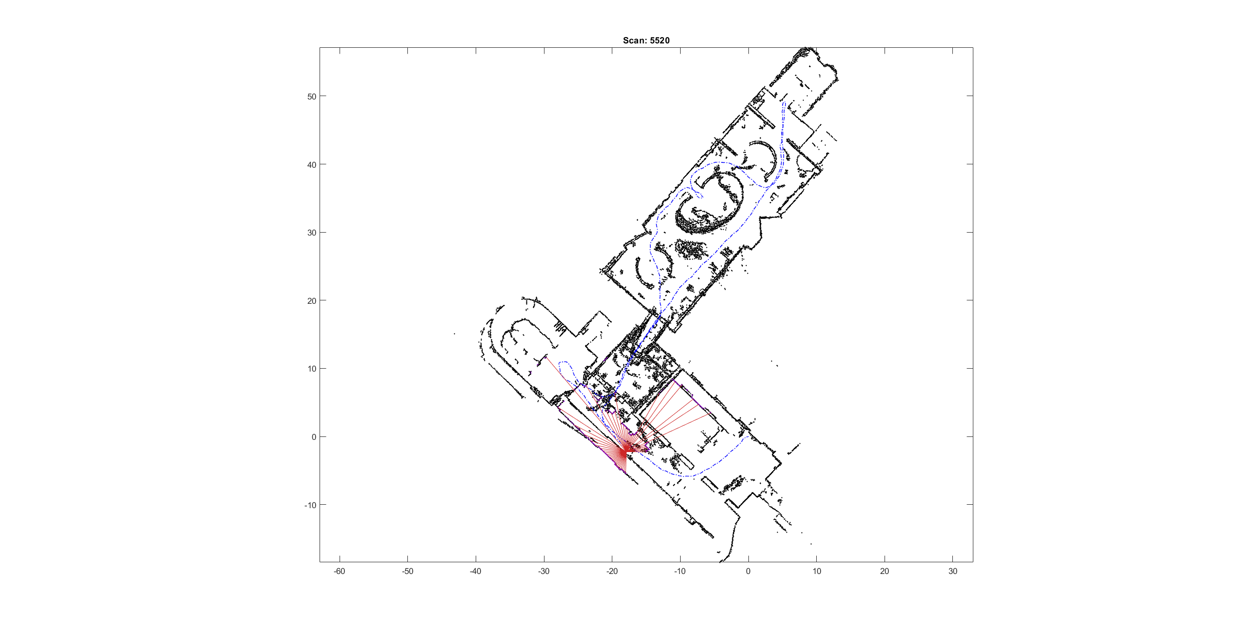
Result and discussion
We explored the importance of Close Loop Optimization
original
Close loop optimized
→ Close loop optimization gets better outcome.
Notes:
~

Slide 21
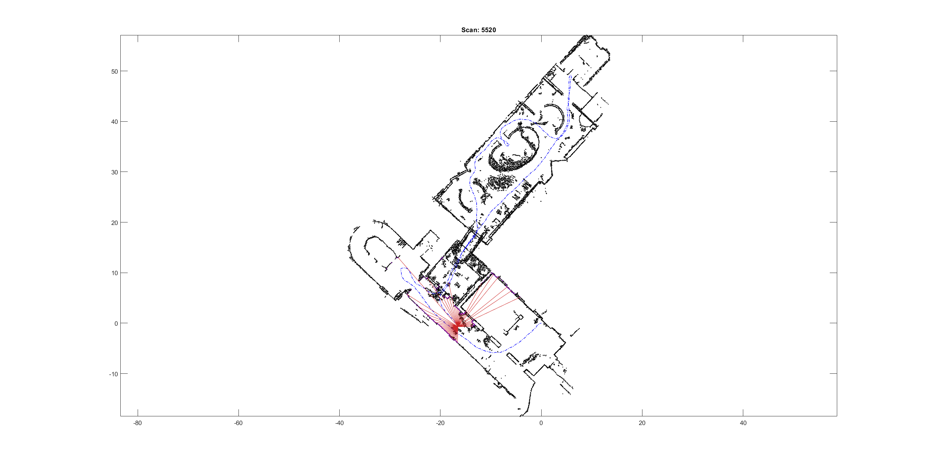
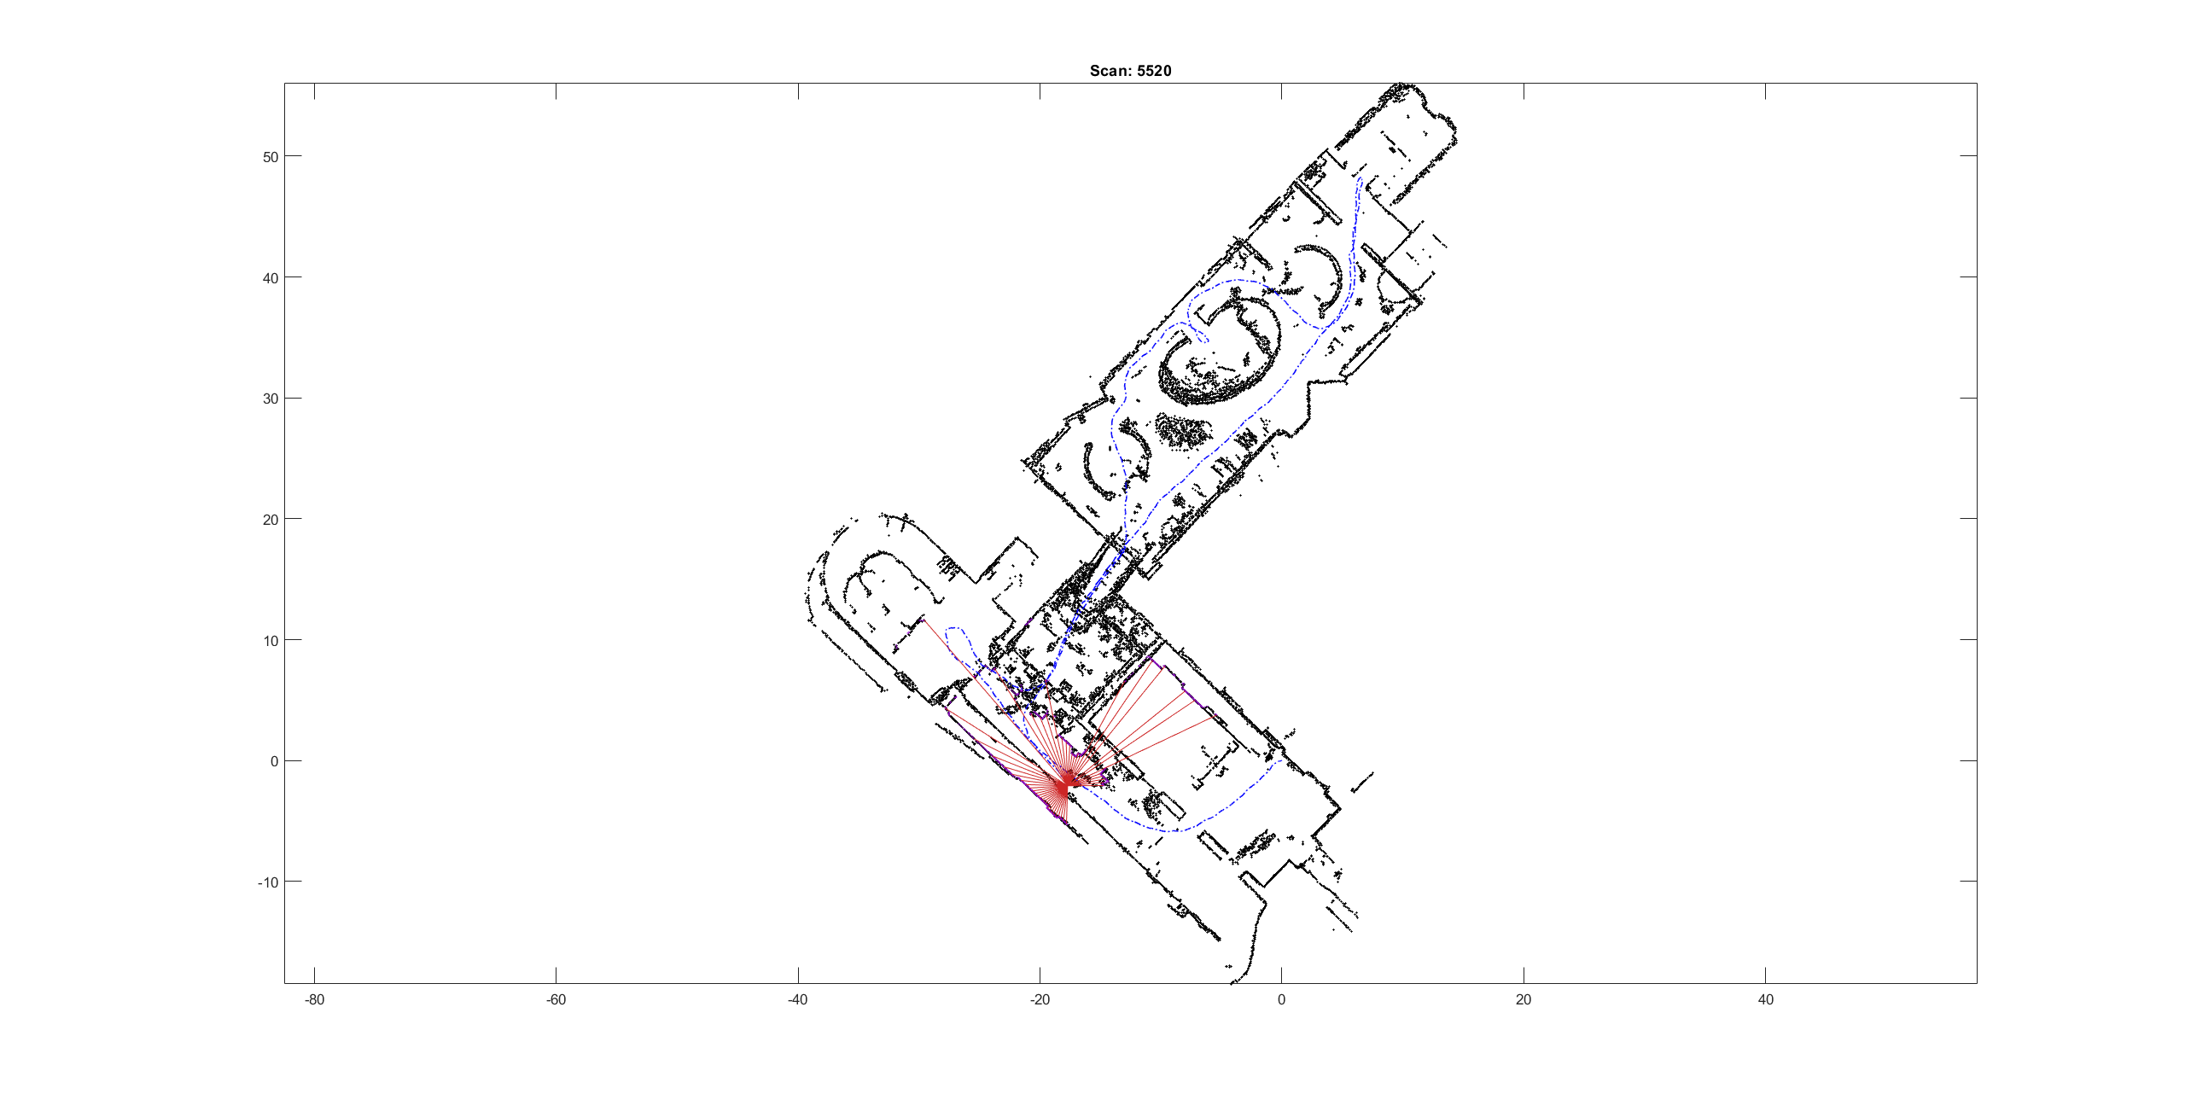
Result and discussion
We still explored the effects of other parameters (e.g., Resolution)
Original
Some overlaps
2 × resolution
Works better
4 × resolution
Sensitive to small errors!
Notes:
We still explore the effects of other parameters on building maps, such as the resolution of local grid maps. Increasing the resolution within a certain range can improve the accuracy, but a higher resolution may make the system too sensitive to small errors, causing larger offset

Slide 22
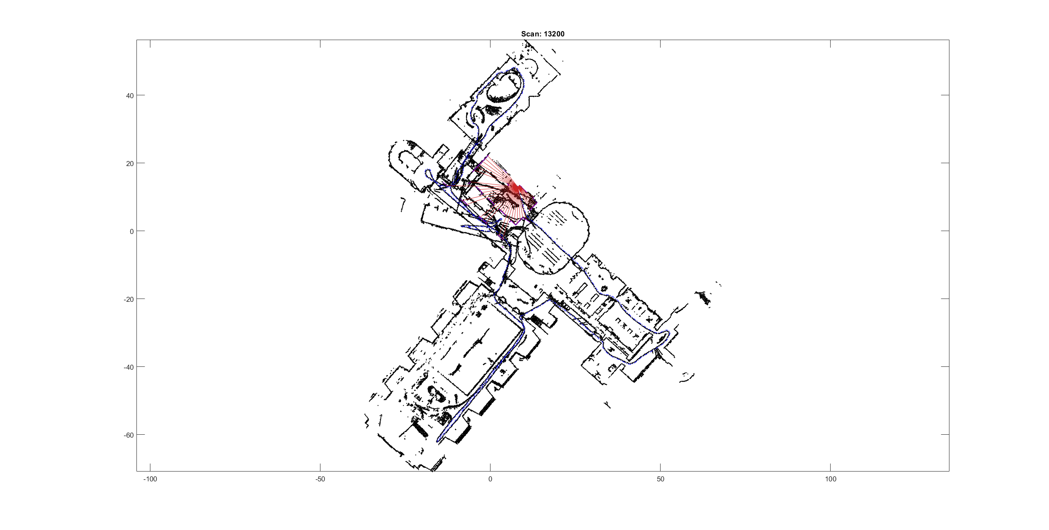
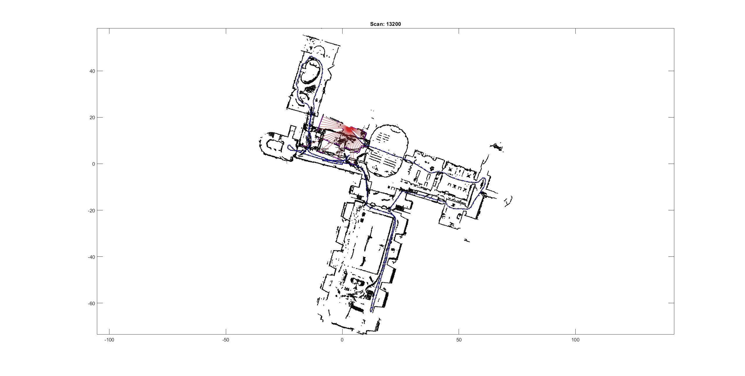
Result and discussion
We also tried other Lidar scan data bags from Deutsches Museum
bias
Incorrect constraint added in global map
Notes:
The slam algorithm is not suitable for map construction for an environment that contains relatively large vacancy, and path with frequent cross-links should be avoided. Due to the lack of an anti-disturbance mechanism, the algorithm is sensitive to lidar noise, and it can be improved via performing preliminary selection of lidar scan based on the intensity column in the dataset.
We can find that since the pose estimation is completely determined by the degree of similarity with the current map, there is a lack of error correction mechanism. At the same time, the scan point in the close-loop of the close-loop optimization algorithm will be considered as the correct point and considered as a global constraint. Hence when an incorrect loop occurs, the error will be further enlarged and cause obvious distortion in the constructed map. Solutions to such problems can be considered in future research.

Slide 23
Conclusion
In this project, we…
Learnt basic knowledge of Lidar SLAM & 2D mobile robot
Built a rudimentary point map for Deutsches Museum
Performed Close Loop Detection which further minimized error
However, there are still some problems left for extended research…

Slide 24
References
[1]Hess, Wolfgang, et al. "Real-time loop closure in 2D LIDAR SLAM." 2016 IEEE international conference on robotics and automation (ICRA). IEEE, 2016.
[2]The Cartographer Authors. “Public Data -- Cartographer ROS documentation”. Google Cartographer ROS, 24 June 2020, https://google-cartographer-ros.readthedocs.io/en/latest/data.html.
[3]MATLAB. “Understanding SLAM Using Pose Graph Optimization | | Autonomous Navigation, Part 3”. Youtube, 8 July 2020, https://youtu.be/saVZtgPyyJQ.
[4]卫浩. “激光SLAM简单入门（1）-matlab读取bag文件并保存为mat文件”. Zhihu, 4 Dec. 2018, https://zhuanlan.zhihu.com/p/51577331.
[5]卫浩. “激光SLAM简单入门（2）-代码解读和分析”. Zhihu, 5 Dec. 2018, https://zhuanlan.zhihu.com/p/51617565.
[6]meyiao. “LaserSLAM”. Github, 13 June 2017, https://github.com/meyiao/LaserSLAM.
[7]任乾. “激光SLAM | cartographer论文(2)”. Zhihu, 4 Dec. 2019, https://zhuanlan.zhihu.com/p/93713565.

Slide 25
Thanks for listening! Q&A

